Slide 1

RISK AND RESILIENCY BOOTCAMP
3

Slide 2


Slide 3
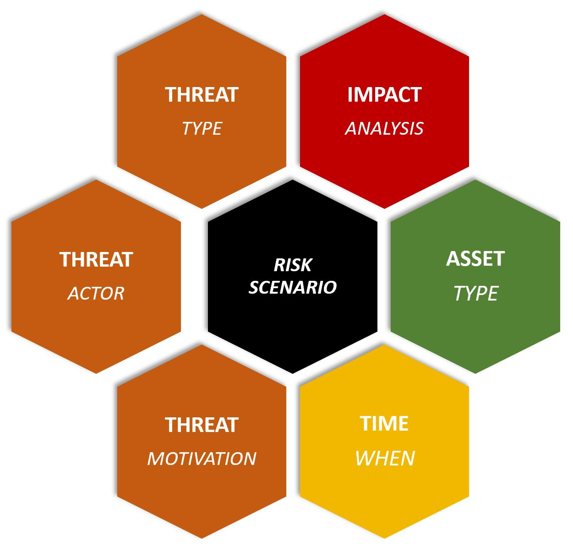
Risk scenarios
In this module we will
Introduce the concept of a risk scenario
Identify where risk scenarios fit into risk and resilience management

Slide 4
Risk scenario
A structured “story”
Describes how a threat could exploit a vulnerability to harm an asset
with stated causes, frequency/likelihood, and business impact
ISACA treats risks as loss event scenarios
This means scenarios are a fundamental unit of analysis for evaluating and responding to risk
Resilience
DRI recommends building and exercising scenarios
To drive preparedness, continuity strategies, and testing
Including worst-case disaster scenarios
Similar to disaster drills in other industries

Slide 5
Step by step
Choose the asset/service and objective at risk
Example: Online banking platform
Objective at risk: secure, available service
State the combination of threat, actor and event
Example: External criminal uses credential stuffing to gain account access
Name the vulnerability/predisposing conditions
Example:
Weak password hygiene
No MFAand
Insufficient rate-limiting for login attempts
Describe the initiating causes and pathways
Example: Leaked credentials from third-party breach and automated botnet attempts

Slide 6
Step by step
Estimate frequency or likelihood
Use qualitative scales or FAIR quantitative estimation where data allows
Estimate business-focused impact
Financial loss, regulatory penalties, downtime, customer churn, reputation
List existing controls and control strength
Preventive, detective, corrective
Take note of the residual risk
Define response and resilience actions
Risk response (avoid/mitigate/transfer/accept)
Recovery objectives, exercises, and communications

Slide 7
Step by step
Structure summary
Scenario title
Asset / business objective
Threat actor / path
Vulnerabilities / predisposing conditions
assumptions AND data sources
Likelihood
Impact: financial, regulatory, operational, reputation
Existing controls and gaps
Proposed treatments controls or responses
Resilience measures: for example RTO/RPO targets
Scenario owner: review cadence (frequency)

Slide 8
Best practices
Be specific and business-anchored
Tie each scenario to a business service, KPI, or regulatory requirement.
Use a standard structure
Asset → Threat/Actor → Event/Path → Vulnerability → Frequency → Impact → Controls → Treatment → Resilience actions
Maintain a reusable scenario catalog
Start with COBIT/ISACA scenario libraries; tailor to your environment and keep them versioned
Quantify when possible
Apply FAIR to translate high-priority scenarios into probable loss (ranges), supporting cost-benefit decisions

Slide 9
Best practices
Exercise regularly, tabletops to live drills
Map scenarios to continuity tests, incident response runbooks, and recovery objectives
Link to controls and assurance
Explicitly reference control objectives and rate the control strength to reveal residual risk
Refresh with threat intelligence and incidents
Update likelihoods/paths as the environment changes; fold in post-incident lessons learned
Govern with cadence
Assign owners, review dates, and acceptance thresholds aligned to risk appetite/tolerance

Slide 10
FAIR Quantitative Estimation
Factor Analysis of Information Risk
Open standard developed by the FAIR Institute and maintained by The Open Group
Used for quantifying risk in financial terms, such as probable annual loss exposure
“How much risk do we have, and how much should we invest to reduce it?”
FAIR breaks risk into two measurable components and a calculation
Loss Event Frequency (LEF) – How often is a loss likely to occur?
Loss Magnitude (LM) – How much loss is likely to result each time it occurs?
Annualized Loss Exposure (ALE) = LEF × LM
Replaces vague qualitative labels like “high impact” with probability ranges and financial outcomes

Slide 11
How to Use FAIR
Step 1: Define the scenario
Start with a clearly stated risk scenario
For example: “External attacker exploits unpatched vulnerability in web server, leading to data breach.”
Step 2: Gather inputs
Use data from
Historical incidents and threat intelligence
Industry benchmarks
Expert judgment
Estimate ranges for frequency and impact
Minimum, most likely and maximum

Slide 12
How to Use FAIR
Step 3: Model and simulate
Monte Carlo simulation (10,000+ iterations) to combine frequency and impact distributions and produce a probable loss range
This produces results like
Most likely annual loss: $600,000
90% confidence range: $250,000 – $1.2M
Tools like RiskLens, OpenFAIR Analysis Tool, or Python @Risk packages automate this
Step 4: Compare controls or scenarios
Quantify how much each control reduces exposure
For example: adding MFA reduces event frequency by 70%
Annual loss drops from $1M to $300K
ROI = $700K reduction / $50K control cost = 14×

Slide 13
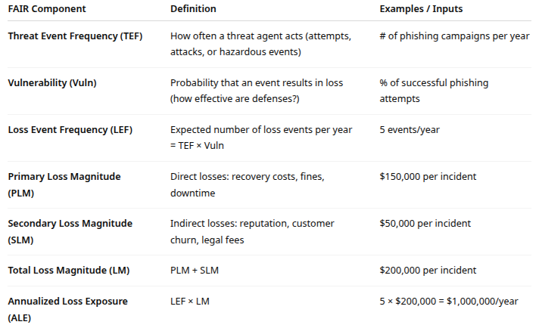
Example: FAIR in Practice

Slide 14
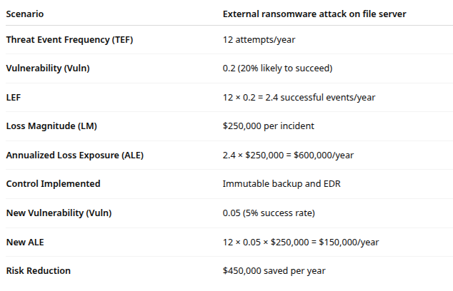
Example: FAIR in Practice

Slide 15
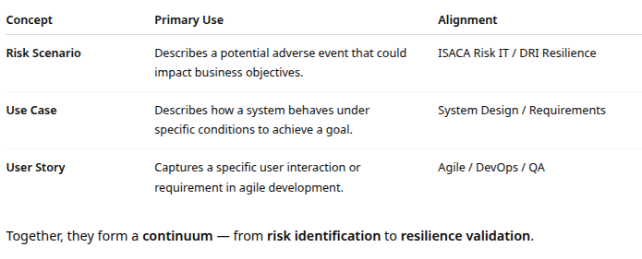
Related tools
Risk scenarios, use cases, and user stories

Slide 16
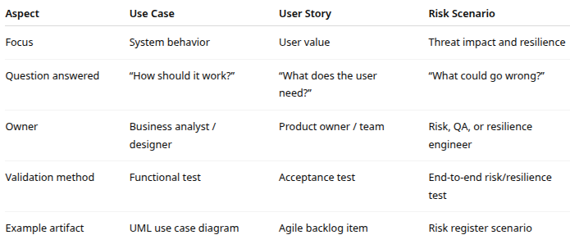
Related tools
Risk scenarios extend use cases and user stories by adding the failure and resilience dimension

Slide 17
From Risk to Test
Start with a risk scenario
“Payment service unavailable due to API timeout”
Map to use case
“Process online payment via API”
Identify user stories impacted
“As a customer, I want to complete my payment quickly”
“As a support agent, I want to see failed payment logs”

Slide 18
From Risk to Test
Design test cases
Functional test: Does the payment succeed under normal load?
Negative test: Does the system handle API timeout gracefully?
Resilience test: Does failover to backup gateway work?
Recovery test: Are pending payments reconciled after restoration?
Each test ties back to a risk statement ensuring traceability from risk identification to verification

Slide 19
Risk scenarios and Test Cases
End-to-End (E2E) testing with risk lens
E2E tests verify complete workflows, crossing multiple systems, APIs, and data layers
Combined with risk scenarios, E2E testing ensures
Key assets (data, transactions, customer flows) are resilient under failure
Preventive and detective controls actually work in production-like conditions
Ensures recovery paths meet
RTO (Recovery Time Objective) requirements
RPO (Recovery Point Objective) requirements

Slide 20
Risk and testing
Best Practices
Map every critical use case to at least one risk scenario
Maintain traceability
Link risk register entries to user stories, use cases, and test artifacts in your ALM or QA tool
Use exploratory risk testing
Encourage testers to explore system behavior under failure or boundary conditions
Test controls, not just functionality
Validate access controls, monitoring alerts, logging, and failover triggers
Automate regression of high-risk scenarios
Use CI/CD pipelines to continuously validate resilience against known threats
Close the loop
Feed real incidents and audit findings back into the scenario catalog for future testing

Slide 21

Q&A and open discussion
Notes:
Now is the time to engage in an interactive Q&A session where you can ask questions, share insights, and clarify any doubts about the topics we have covered so far.
This open discussion is designed to ensure that every participant has the opportunity to voice their thoughts and learn from the collective experience of the group.
Your questions and comments are valuable as they help us identify areas that may need further explanation and enable us to tailor future sessions to your needs.
We encourage you to speak up and contribute to the dialogue, as this interaction is one of the key components of our interactive learning approach.
As the session progresses, take note of any questions or ideas that you would like to revisit, and feel free to share your perspectives with the class.

